Slide 1
Understand the different types of software and hardware security
Explain how to implement precautions for security measures
Evaluate preventatives measures to suggest best practice
Different software and hardware measures
discussion

Slide 2
Anti-virus software and detection techniques
Anti virus software is a utility program that is used to protect from malware. It usually detects malware through the use of “signature detection”. The anti-virus companies analyse malware and identify a pattern (the signature) for the malware code. This acts like a fingerprint that can be compared to programs on your hard disk to identify the viruses.
However, it is common for anti-virus software to also use “heuristic detection”. With heuristic detection, the anti-virus monitors the behaviour of programs and detects anything that appears suspicious, such as trying to copy itself into another program. This allows the anti-virus software to identify malware, even without the virus signature

Slide 3
Anti-Virus: Dealing with threats
Once a virus has been detected it is normal for an alert to be presented to the user so they can decide what to do with this threat. It’s important that the anti-virus doesn’t automatically delete the file, as there can be false positives made, especially by heuristic detection.
The three options you will most commonly be presented with are:
Clean – removing the malware from the file, without removing the file itself. This may not be possible in all cases, but is often the best option for a virus (as opposed to other types of malware).
Quarantine – this moves the malware to a secure location on the computer and prevents it from executing or spreading. This is useful to do before deleting so you can investigate whether it has been correctly identified as malware or not.
Delete – removing the file completely from the computer. This is a quick and safe way to protect your system, but remember, any data stored in an infected file will be gone with it.
Many anti-virus programs will automatically quarantine files that appear to be malware. This will then give you the option to choose whether to clean or delete the file.

Slide 4
Software firewall and hardware firewall
A firewall is either a hardware device or a utility program that monitors incoming and outgoing network traffic and blocks any traffic that it deems suspicious.
The difference between the hardware firewall and the software firewall is that the hardware firewall is an actual physical device that will sit between your local area network and the internet. Whereas the software firewall will be installed on each individual device.
This means the hardware firewall can stop bad data from ever entering the network, while software firewalls can offer closer controls over specific devices and how they interact with the network and internet.
There are a few differences between the two types of firewall which are shown on the next slide.

Slide 5
Software firewall vs. Hardware firewall
Pay attention to differences as this is crucial to activity 3 for alternatives
Software Firewall | Hardware Firewall
A software Firewall operates on the system. | Hardware Firewall do not operate on the system.
Configuration of a software firewall is easy. | Configuration of hardware firewall is not easy.
It is installed on individual devices like computes and phones which results in blocking users or devices from accessing the individual components of the network. It basically inspects the packets and then blocks the unauthorized access. | It is required to install the device between the computer and the Internet so that it will not be easily accessible. The installation requires a connection of network cable with the firewall rather than directly connecting to the router. Hence, a barrier is formed for blocking the incoming and outgoing data packets between the network and the Internet. It protects against viruses, malware, spyware, email spam, and other similar attacks from outside.
It is less expensive to install. | It is more expensive than a software firewall as an initial investment is required based on the protection level.
It is flexible i.e. you can choose which application has to be installed. | It is not flexible like software firewall.
It is installed inside the individual system. | It is installed outside the system.
It protects one system at a time and is not enabled for smart TVs, gaming consoles, and other devices. | It protects a whole network at a time.
It makes the performance of computers slows down. | It doesn’t affect the performance of the computer.
It is needed to be installed on every individual system on a network. | It needs only one hardware to be installed for a whole network.
In software firewall, content based on keywords can be blocked. | A domain or website can be blocked using hardware

Slide 6
Filtering techniques
There a number of different filtering techniques that firewalls can use. We will explore the following:
Packet filtering
Application level awareness
Inbound and Outbound rules
NAT

Slide 7
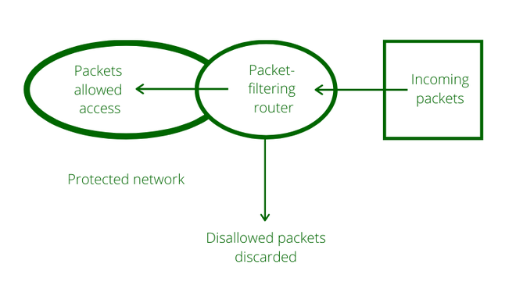
Packet filtering & inspection
With packet filtering, the firewall inspects each packet of data and compares it to pre-defined security rules (known as the firewall policy, or ruleset). If the packet is flagged by the rules, then it is prevented from passing through the firewall.
You could permit or deny packets based on rules such as
The source IP address
The destination IP address
Protocols
Ports

Slide 8
Application level awareness
An application firewall is a form of firewall that controls the input and output of packets to an application. This is important as hackers may attack a network directly at the application layer, exploiting flaws in the security of specific applications. So, if an attacker gets past the network firewall, there is an added layer of protection.
Notes:
his feature is part of software-defined networking (SDN)

Slide 9
Inbound and outbound rules
Inbound and outbound rules are used as part of the filtering performed in packet filtering and application filtering. The security rules mentioned in slide 7 are referred to inbound and outbound rules.
Inbound rules will define what data should be accepted, rejected or dropped from entering the network or computer. While outbound rules will do the same for data leaving the network or computer.
We mention the terms accepted, rejected and dropped. These are the responses that can be performed by these firewall rules. These can be summarised as:
Accepted – allow the traffic through.
Rejected – do not allow the traffic through and send an “unreachable” reply.
Dropped – do not allow the traffic through and send no response.

Slide 10
Network address Translation (NAT)
This has already been mentioned within section B but is relevant to A5 also.
All devices on a network are assigned an IP address to uniquely identify them. We often use these addresses in firewalls as part of our rules as we may want to block or allow data from or to a specific address or range of addresses.
We can use Network Address Translation to assign private IP addresses to our devices within our private network. The NAT will translate our private addresses to our public internet gateway address when sending or receiving data over the public internet.

Slide 11
Authentication
User authentication systems, such as through the use of a username and password, will log in the user to the system authorising them to access certain areas and perform certain functions.
The username is used to uniquely identify each user and is not kept secret. Usernames don’t have any particular rules on complexity and are often simple words, however, it is still important in allowing us to ensure different users are given the correct access rights.
The password is used to authenticate the user as the person who should have those access rights. These passwords have to be kept private and secure to prevent attempts to gain unauthorised access, such as through brute-force attacks. Secure passwords should:
Not contain a dictionary word
Have uppercase and lower case letters
Be a min of 10 char in length
This will protect against brute-force attacks.
Another method of authentication is through graphical passwords which works by:
Presenting the user with a screen full of images
User will select the images (or a number of images) in a specific order
As people remember images better than words this encourages more complex passwords, making this system more secure.

Slide 12
Biometric authentication
This has become very popular in recent years with many smartphone devices have built-in fingerprint recognition and some offer facial recognition. These are the two most common forms of biometric authentication.
This information is very unique to each individual and difficult to fake. This makes it generally more secure than passwords, particularly the simple passwords that many users typically choose.

Slide 13
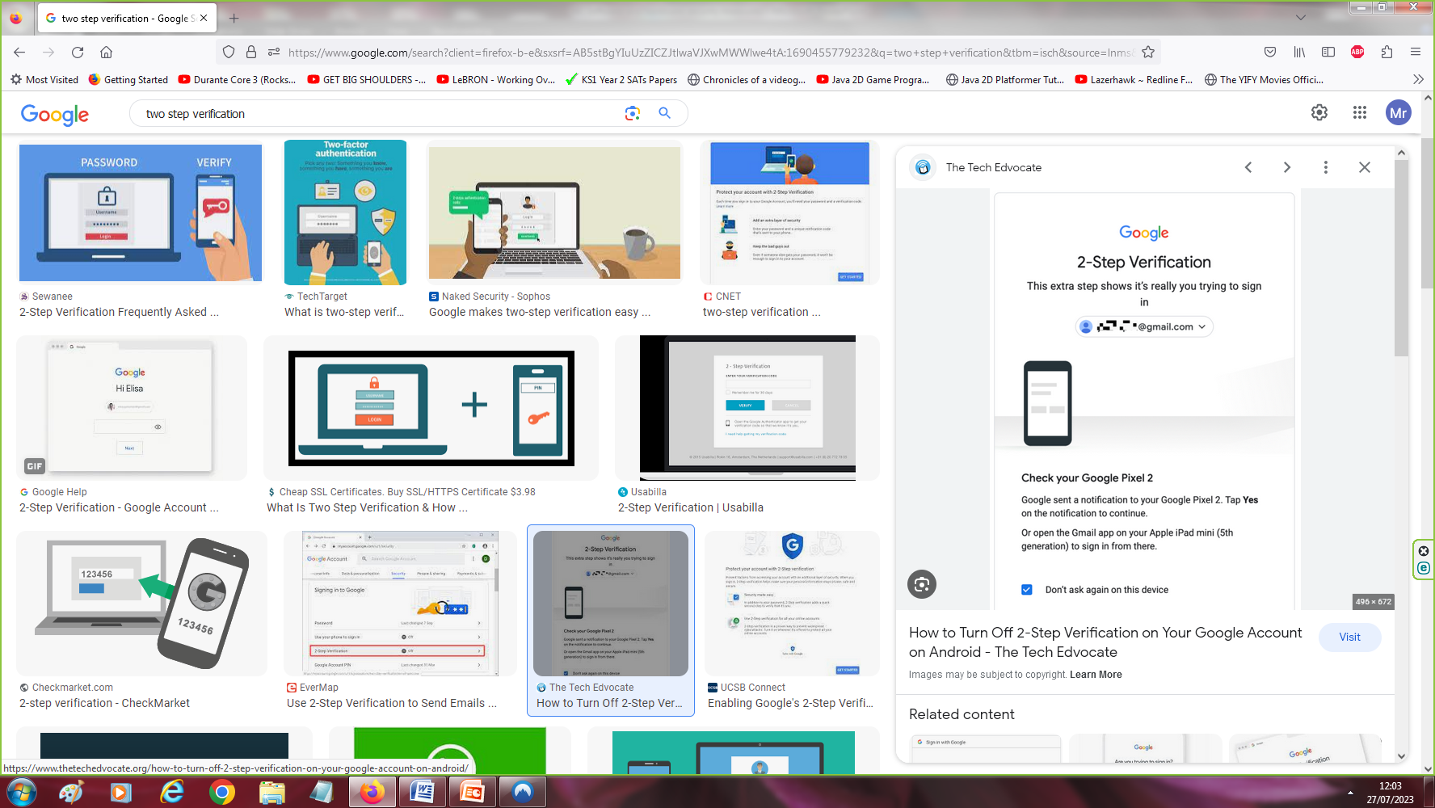
Two-Step Verification
This is often used as an additional layer of security by asking a user to verify their identity more than once, one after the other.
This usually works by a user entering a password and then receiving a unique code by email or text, which they then must enter to gain access. There are also apps that can be used that will provide a time-based one-time password to enter as the secondary authentication.
However, any two authentication methods could be used together for two-step verification, such as fingerprint authentication, followed by a password.
This adds security as the attacker doesn’t just need the password, but additionally access to a secondary system, such as the user’s email, text or the password generating app.
Image demo of two step verification.

Slide 14
Security tokens
These are small hardware devices which the user carries around with them to authorise access to a network or area. Often this is a USB device you plug into your computer or a key fob that uses near field communication(NFC) to wirelessly authenticate.
This can be used on its own but is often used with an additional authentication method such as a password. The reason for it not being used on its own is that it is very vulnerable to loss, theft or even copying.
NFC Explained below:
NFC is wireless communication between two devices which activates a transfer of data or power. A bit like Bluetooth or Wi-Fi, except it uses electro-magnetic radio fields instead of radio transmission so when two compatible NFC chips come in to contact with each other, they’re activated. NFC operates across a typical range of 4cm to maintain a level of security for the data being transmitted, hence the name – Near Field Communication.

Slide 15
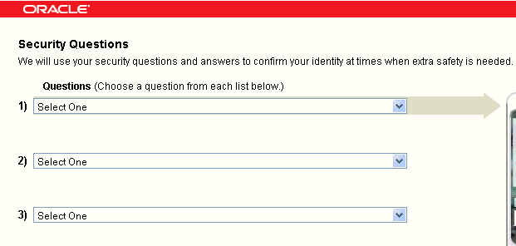
Knowledge –Based authentication
This authenticates a user through the use of question and answers pairs. A user will be asked one or more questions which the user must answer correctly to authenticate themselves.
We most commonly see this in authenticating a user for a password reset, where the user has set a question and answer which they must get correct before being sent a password reset email.
It can however also be used in a two-step authentication process, but wouldn’t be used on its own for access as these questions usually involve answers which are not difficult to discover and may even be common knowledge.
Example of KBA

Slide 16
Kerberos –Network authentication
Kerberos is a computer network authentication protocol. This protocol involves a client first authenticating itself with a server called the “Domain Controller”. Once authenticated the client will be able to request access to network resources from the domain controller for a period of time.
It does this through a ticketing system to authenticate users which is encrypted using different passwords for different resources. No password is ever transmitted though, including the user’s password, which protects from a variety of threats.
It is considered a very secure protocol for accessing network resources and is used in most Windows networks. This is really useful to prevent man in the middle attacks from occurring. A man-in-the-middle attack is to impersonate the server, resulting in the user thinking that he\she has connected to the legitimate server, when in fact he\she is talking to the attacker. Since Kerberos performs authentication not only the end user’s identity but also the server’s identity, these types of attacks can be prevented.

Slide 17




Kerberos –Network authentication example
Database store(user credentials stored here)
In this example the client wants to access the file server.
Key distribution centre(KDC)(GREEN)
Ticket Granting Server(TGS)
Steps
The client will make a request to the KDC. It will first go to the AS. The request is encrypted with a secret key.
When authentication server gets the client request it will retrieve clients password from database based on userID credentials stored.
The client’s password is used to decrypt the client’s request. The client is now verified.
The AS sends back a ticket which is called a ticket granting ticket(TGT) back to the client which is encrypted with another secret key.
When the client receives the encrypted TGT then the client sends this to the (TGS) along with its request e.g. I want to access file server
When the TGS gets the TGT it decrypts the ticket with the private key shared with the AS.
The TGS issues the client with a token which is encrypted with another secret key.
The client sends token to the file server.
The file server decrypts token with secret key (this key is shared between the TGS and file server)
The file server allows the client to use it resources for a certain period of time according to the token time period
Authentication server
Client
File server

Slide 18
Certificate based authentication
This uses a digital certificate to identify a client on a network. In a business network, a user must be issued a certificate for their device which will be stored on it locally. This digital certificate is used to encrypt data (with the certificates key) that can be sent to the server and decrypted (using the servers private key) to authenticate the user. The user will then be authorised to access the resources.
This is usually used alongside a username and password system and adds far greater security to it by ensuring only authorised devices can access the network resources.
Notes:
https://www.youtube.com/watch?v=MgYK3-teO_E

Slide 19
Digital certificates & Certificate authorities
A digital certificate (or public key certificate) is an electronic document that verifies that the sender of a message over a network is who they say they are. It also provides the information the recipient requires in order to encrypt a response (i.e. the senders public key).
A certificate authority issues digital certificates to organisations. When a browser receives a digital certificate, it will verify the identity of the certificate sender with the CA, so they know the data they’re sending is going to the correct destination.
Notes:
When using encryption on data during transit, a different key is used to encrypt the data as that which is used to decrypt the data. These two keys are known as the public and private keys.
Data that we are sending will be encrypted using the recipients public key. The sender will have access to that key because it is “public” and so anyone can access it. Usually, it is shared through the digital certificate. The recipient can then decrypt the message with their private key. This is not shared with anyone and is kept securely on the server.
The public key cannot be used to decrypt the message, only the private key can.

Slide 20
Use of Encryption
Websites like Facebook require us to choose a password which they will store on their servers. If the website’s servers are hacked, they could gain access to all the user details, including the password. This is why stored passwords should always be encrypted. This way if a hacker accesses the website’s server, they will only have the encrypted password, which means they won’t be able to use it.
Encrypting files, folders and discs is sometimes used where greater security is needed. For example, if you’re storing confidential data, such as financial records, on a shared computer, the device could be used by people who shouldn’t have access to that financial data. We, therefore, need some way of preventing others from accessing that data on the device. We do this by encrypting specific areas of our computer so that the other users of the computer system will not be able to access them.
Digital rights management refers to a technology which attempts to control access to copyrighted material. DRM often uses encryption to protect copyright material in this way. So, for example, a movie may be encrypted, and the end user will require a decryption key in order to watch the movie. This might be provided through online authentication, or by being built-in to your Blue-Ray player.
Many devices, particularly mobile devices like smartphones and tablets, come with built-in encryption. This encrypts our data on our mobile devices, including messages we send. This provides great security for our device which is needed as we store and send so much confidential data on them nowadays.

Slide 21
The Onion Router (TOR)
TOR is a method for individuals to use the internet with anonymity. TOR encrypts the data multiple times, which then passes it through multiple relay servers which each remove a layer of encryption. Once each layer is removed the original data can then be passed onto the destination.
The amount of encryption and relaying of data to slowly remove it makes finding the original source of data impossible (without exploiting some other vulnerability) so users are completely anonymous, hence why it is used and associated with some very criminal uses of the dark web.

Slide 22
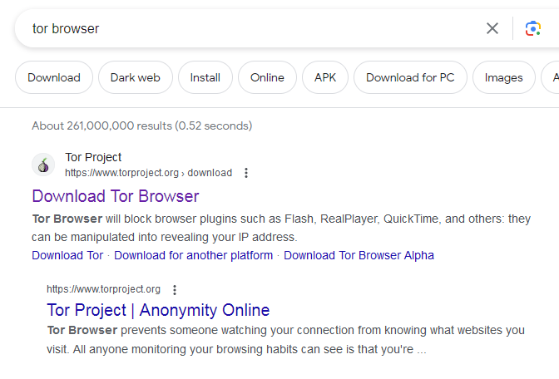
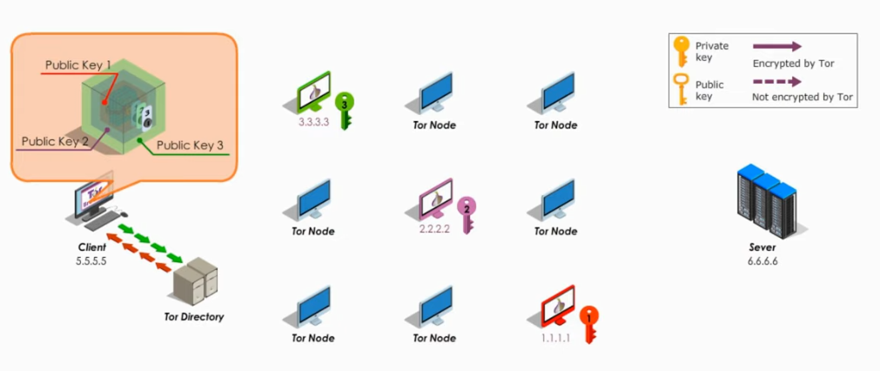
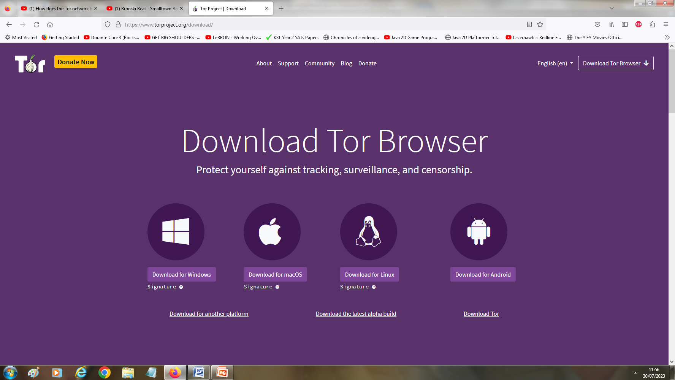
(TOR) further explained
Tor can be installed through the use of a browser which will then connect to a series of TOR routers
A
C How TOR works
Server
6.6.6.6
The Client uses the TOR browser which accesses the TOR directory which has a list of all volunteers who have TOR running which will be used to route your traffic to your end destination. It picks out 3 random nodes\Tor Routers which will act as your route. It will consist of an entry guard(1st node), middle relay(2nd node) and exit node(last node). Each node will encrypt your data using its public key before the data is sent. As you can see in the image you have a green key, pink key and red key. These are your random TOR routers which data will pass through. Each time it passes through the TOR router it uses its private key to take a layer off which in turn reveals the next destination in its route. This continues until it reaches the server. So the public key and private key are both used to encrypt and decrypt. This is Asymmetric encryption.
B
Two screenshots above A and B show TOR browser installation.
Notes:
See more

Slide 23
VPN
A VPN creates a secure connection over a public network (the internet) through the use of encryption. This works by connecting to a VPN server, where the data between your computer and that VPN will be encrypted using asymmetric encryption.
VPNs are commonly used by businesses to allow users to access the businesses local area network securely while away from the office. The business will have a VPN server that you can connect to and then that VPN server will have a connection to the company’s LAN.

Slide 24
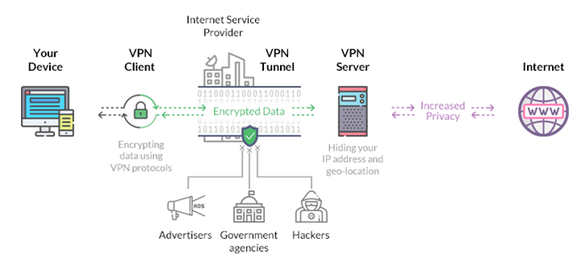
VPN further explained
When you use a VPN, it encrypts all your data on the client side. Then after the data is encrypted, it's passed through a VPN tunnel which others can’t access, and then it reaches the internet.
But before going through the VPN tunnel, the request is first sent to your ISP, but as it's encrypted, ISP can’t figure out what you are trying to access. So it forwards your request to your VPN server. Then the VPN sends the request to your desired IP address or website.
Using a VPN can keep your identity safe and also keeps your data encrypted while you browse the internet. As a result, it enhances security and the chances that someone might hack you will be lower.
Research drawbacks of using VPN which will help with activity 3 of exam

Slide 25
HTTPS
HTTPS is communication protocol that uses TLS or SSL encryption to securely transmit data through a web page. TLS uses asymmetric encryption. This means it uses two different keys:
The private key. This is controlled and maintained by the website owner and is located on the web server. It decrypts information that is encrypted by the public key.
The public key. This is available to users who want to securely interact with the server via their web browser. The information encrypted by the public key can only be decrypted by the private key.
HTTPS uses port 443 by default, whereas HTTP uses port 80. All secure transfers require port 443.
Example
A customer visits a website to purchase an item. To place the order, the customer is prompted to enter personal details (e.g., their name and shipping address), as well as financial data (e.g., their credit card number). HTTPS encrypts this data to ensure that it cannot be compromised or stolen by an unauthorized party, such as a hacker or cybercriminal. The order then reaches the server where it is processed. Once the order is successfully placed, the user receives an acknowledgement from the server, which also travels in encrypted form and displays in their web browser. This acknowledgement is decrypted by the browser's HTTPS layer.

Slide 26
Access control
Access control is needed to restrict access to resources such as files, folders applications & physical resources.
Has three main areas:
Authentication: Already covered in previous slides
Authorisation: file permissions & privileges that define what users can access
Audit: audit log of user behaviour for monitoring behaviour & security
Authenticating the user isn’t enough. Once a user is authenticated this will authorise them to access certain resources. This includes the files that they can access (and what level of access), the software they can access, and the functionality they can perform (such as installing software). Organisations should work on the “principle of least privilege”. This means users can only access the data, software and functionality they need to do their job.
Finally, after authorisation there is an audit. We will maintain an audit log of how users use the network, including when and where. This can ensure appropriate use and help identify where a threat has occurred.

Slide 27
Trusted Computing
Trust computing is a term used for a technology that ensures hardware has security built-in so that devices will perform in predictable and secure ways.
It takes away the control of security from the user, thus removing them from the possibility of deliberately or accidentally causing a threat to occur.
It does this by using a chip, called a trusted platform module, which will store encryption keys & other data that are inaccessible from the rest to the computer system.
Examples can include Windows Hello, Blackberry Android Phone.

Slide 28
Protect Wireless local Area Network(WLAN)
Wireless networks can be especially vulnerable to attack, as malicious users trying to connect to them do not need physical access to any equipment. They could even potentially connect outside the office building. This makes them naturally less secure than wired networks.
Therefore, we need to take some precautions to ensure only authorised users are connecting to our wireless local area network.
First two precautions to be looked at are :
Networking cloaking
Mac address filtering

Slide 29
Network Cloaking
Networking cloaking hides the service set identifier(SSID) so malicious users wont know it’s there. The SSID is what we refer to as the name of the wifi network. Here is an example below:
To hide the SSIDs McDonalds
You would use the Netsh command, open command prompt and enter command below:
netsh wlan add filter permission=block ssid=McDonalds networktype=infrastructure
To display the SSID McDonalds again
Enter command below:
netsh wlan delete filter permission=block ssid=McDonalds networktype=infrastructure
Block All Wi-Fi Networks & Allow (Whitelist) Your Wi-Fi Network(s)
First deny all Wi-Fi networks by entering command below:
netsh wlan add filter permission=denyall networktype=infrastructure
Then add your wifi network by enter command below:
netsh wlan add filter permission=allow ssid=McDonalds networktype=infrastructure
Pay attention to commands as this may be used for test plan in activity 2 of your exam

Slide 30
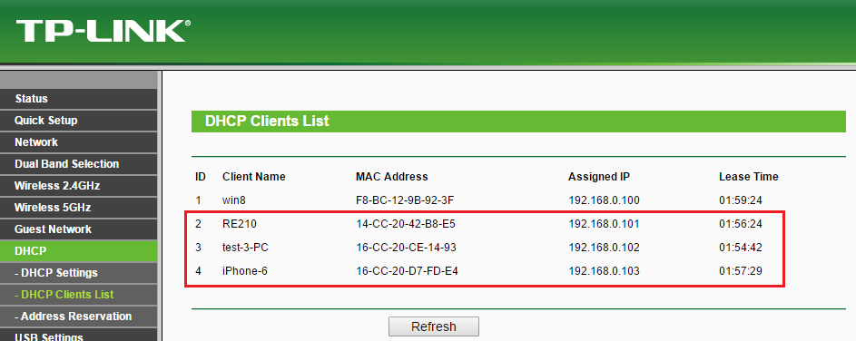
MAC Address filtering
Before letting any device join the network, the router checks the device's MAC address against a list of approved addresses. If the client's address matches one on the router's list, access is granted as usual; otherwise, it's blocked from joining.
To set up MAC filtering on a router, the administrator must configure a list of devices that are allowed to join. The physical address of each approved device must be found and then those addresses need to be entered into the router, and the MAC address filtering option turned on. Once you have the list of MAC address, go into the router settings and put them in their proper places.
Image of TP-Link router with MAC address filtering

Slide 31
Wireless Encryption
Wireless encryption protects our network by ensuring data being transmitted wirelessly is scrambled and so unauthorised devices cannot access it. The three main types of wireless encryption are:
WEP – Wired Equivalent Privacy was an early wireless encryption method. It is considered incredibly insecure now and a WEP password can be easily cracked. Even so, it is still heavily in use due to people using outdated wireless routers or not having the knowledge as to how to change their encryption type.
WPA2 – Wi-Fi Protected Access 2 replaces WEP. It uses AES encryption which is considered incredibly secure which also includes enforcing longer passwords.
WPA3 - Wi-Fi Protected Access 3 is the latest version of wireless encryption replacing WPA2. This uses 256 bit encryption compared to 128bit encryption used by its predecessors. This makes it even tougher to break through the encryption.

Slide 32
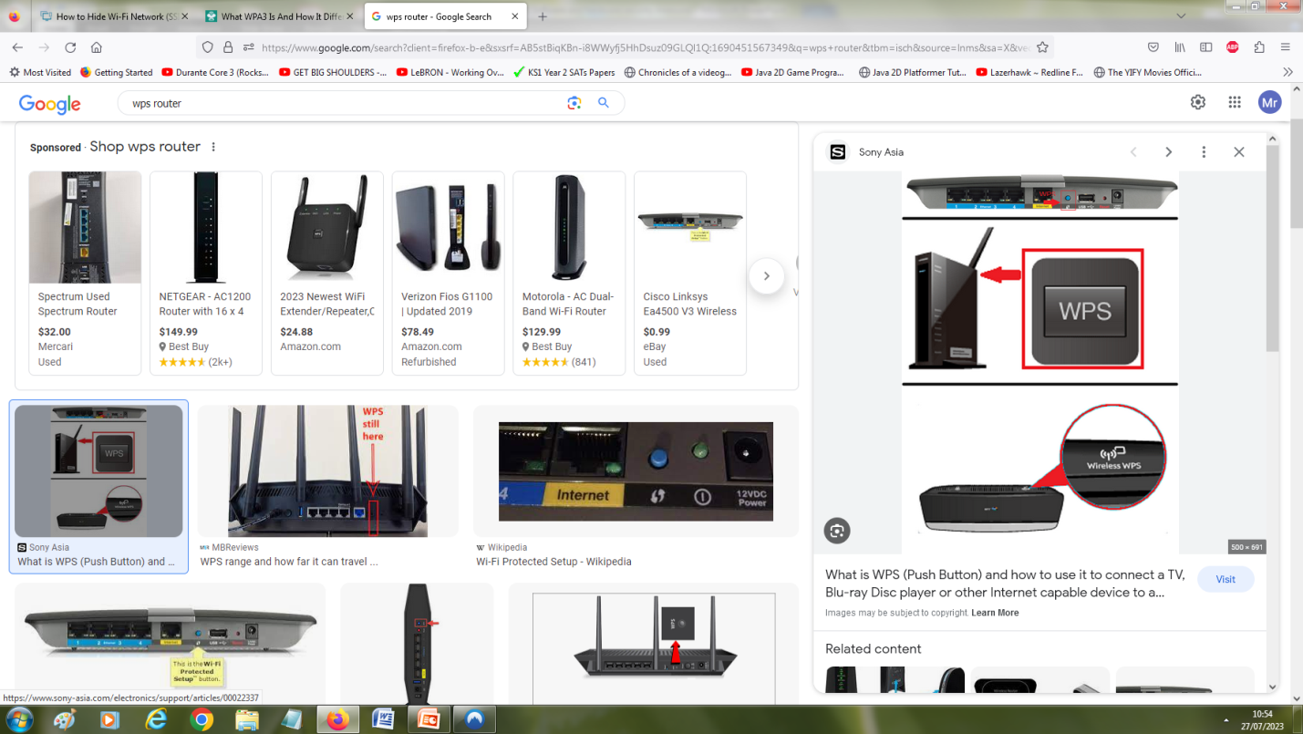
Wireless Encryption Cont
Another wireless encryption technology is Wi-Fi Protected Setup (or WPS). It was designed to make WiFi encryption secure but instead of using a long password, you could use an 8-digit pin or a push button method for syncing devices onto network.
However, routers using a WPS pin method were found to have a serious security flaw using the WPS pin recovery system which could be easily brute-force attacked and gained access to.
Image shows router has WPS button features when pressed which will send signal to other device to connect to it.

Slide 33
Wireless Encryption Vulnerabilities
There are some serious vulnerabilities to WLANS such as the ease of cracking some passwords.
We can mitigate these with some simple procedure such as:
Use WPA2\3 encryption rather then WEP
Hide SSID
Turn off the WPS feature
Regularly update wireless router firmware

Slide 34
Consideration of Issues during design
Before implementing a WLAN you should design the network & system with security in mind. Key areas that should be considered and included in your design are:
Network firewalls, intrusion detection systems and virtual private network protection.
Content inspection systems, such as anti-malware programs, anti-spam and URL filters.
Network Compartmentalisation, i.e. splitting the network into several different zones based on threat susceptibility.
Principle of least privilege, where users and administrators only have access to information necessary for them to be able to complete their role.

